Slide 1
CMM 262
Quantitative Genetics / Genomics

Slide 2
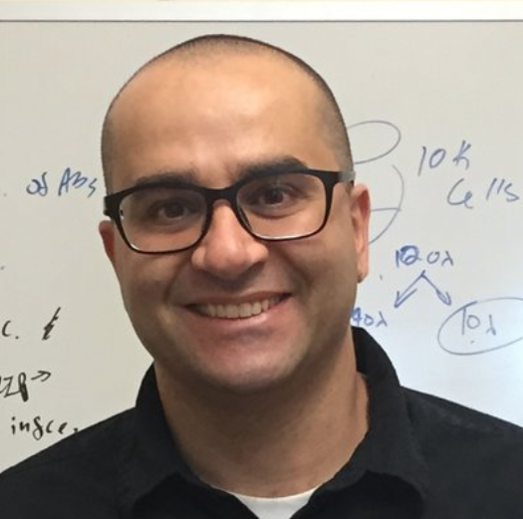
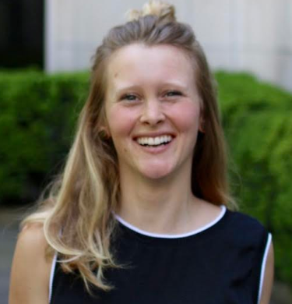
Instructors
Course Director
TAs
Dana
Nachmanson
Michelle
Ragsac
Clarence
Mah
Dr. Alon Goren

Slide 3
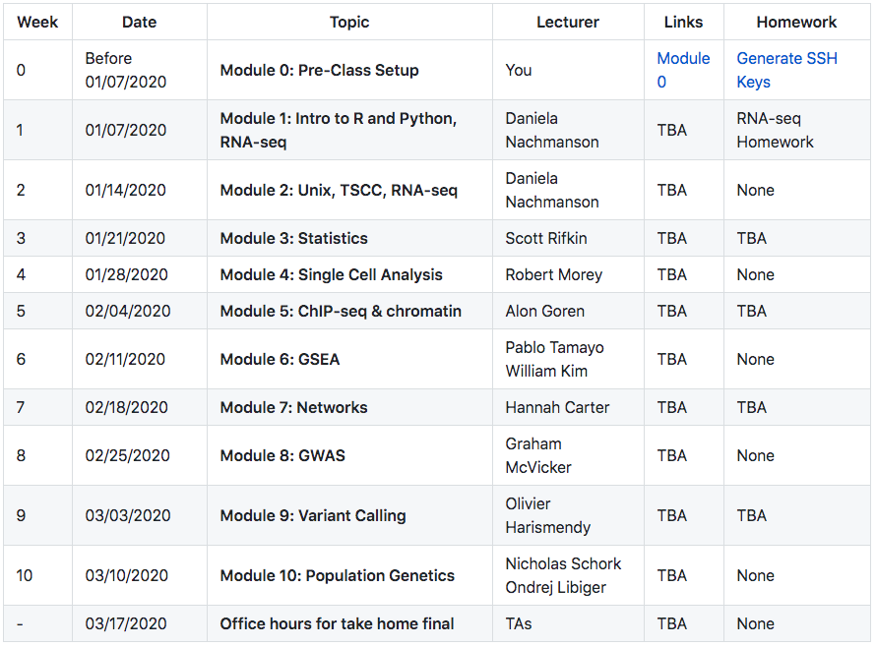
Course overview

Slide 4
Why to take this course
Important knowledge for all biology students
Experts from each field (great networking)
Will provide broad overview of:
Basic programming
Basic bioinformatics pipelines and tools
Biological data analysis skills from a diverse array of fields
Notes:
Main goals are to arm you with some very basic programming skills, and biological data analysis skills. To give you a very brief glimpse of different types of biological data analysis from experts from each field (except for first 3 lectures)
Biology is increasingly computational, we are not taking 10 measurement on a mouse and then reporting that, now we are xenografting tumors into mice and then sequencing them, modeling cell evolution. Cannot be afraid of computer science, math or statistics. They are your friends. You are smart!

Slide 5
Disclaimer
Each module could be a complete course (or years of courses)
Large breadth, but small depth
To get deeper into each topic:
Take another course
Find online tutorials
Pair up with a bioinformatician
Always best to seek expert advice when doing an analysis you are inexperienced with
Notes:
So while you will definitely learn some useful tools that you can take back into the lab with you, note that it is very important that you are not afraid to consult with experts or those more experienced than you for your analysis. Especially if it is not a simple one. But even if it is a simple one.

Slide 6
General class logistics
Bring laptop and charger – class is interactive
No food or drinks in MET upper auditorium
GitHub is our main class website: https://github.com/biom262/cmm262-2020

Slide 7
Module
Each module has learning objectives
Slides and notebooks will uploaded after each class
We might ask you to install specific packages before a class
We will ask for feedback after each module

Slide 8
Homework
Assigned every other week on Thursday (except first 2 weeks)
Due the following Thursday at 8:59am (just before class)
Will be using GradeScope
Follow homework guidelines!
First late assignment – 10% off each day
Subsequent late assignments – 20% off each day

Slide 9
Exams
Midterm:
Assigned: 02/07
Due: 02/18
Final:
Assigned : 03/14
Due : 03/24

Slide 10
Extra credit – GitHub contributions
Github:
Contribute to the course materials for potential extra credit points!
Pro #1: Learn how to use GitHub
Pro #2: Extra grade boost!
Surveys:
Submit survey responses for 8/10 modules and receive +3% overall course grade

Slide 11
Office hours
Tuesday after class
If you have questions, email Dana, Michelle or Clarence

Slide 12
Class Communication
Announcements via list serve
Let us know if you didn’t get the emails!
Slack channel for HW discussion
Questions go to Dana, Clarence and Michelle
dnachman@eng.ucsd.edu
mragsac@eng.ucsd.edu
ckmah@ucsd.edu
(Don’t email us at midnight please. It’s very distressing.)

Slide 13
Questions
Ask questions!
This course is for you
Makes it more interactive
Practice for asking questions in talks
Tells instructor if they were clear or need to expand on something

